Slide 1



EPIONE :
A Medical Appointment’s Portal
Submitted by :

Slide 2







MEET THE TEAM
Majoul AAbdEjlil
Bouhija Mayssa
Loueti Souha
Garouachi Emel
Ben Aziza Chaima

Slide 3

Plan
Introduction
Analysis of the existing solutions
Functional analysis
Diagrams & Architecture
Mockup & Scenarios
Conclusion

Slide 4
Introduction
Notes:
Nowadays ,computer science occupies an important place in the daily life of the human.
It is everywhere ..
IT has brought us comfort !

Slide 5


IT has brought us Comfort
IT is everywhere

Slide 6

Our Client
Powerful platform
monitor and optimize
Hospital Operating Rooms (ORs)
Notes:
DeepOR is a powerful platform to monitor and optimize the use of Hospital Operating Rooms (ORs),
DeepOR's target is to improve quality of healthcare delivery and increase financial outcomes for a hospital.

Slide 7
Analysis of the existing solutions

Slide 8

Problematic
Patient need to go to the doctor’s cabinet:
checks his availability
wait for the confirmation which costs time and money.

Slide 9

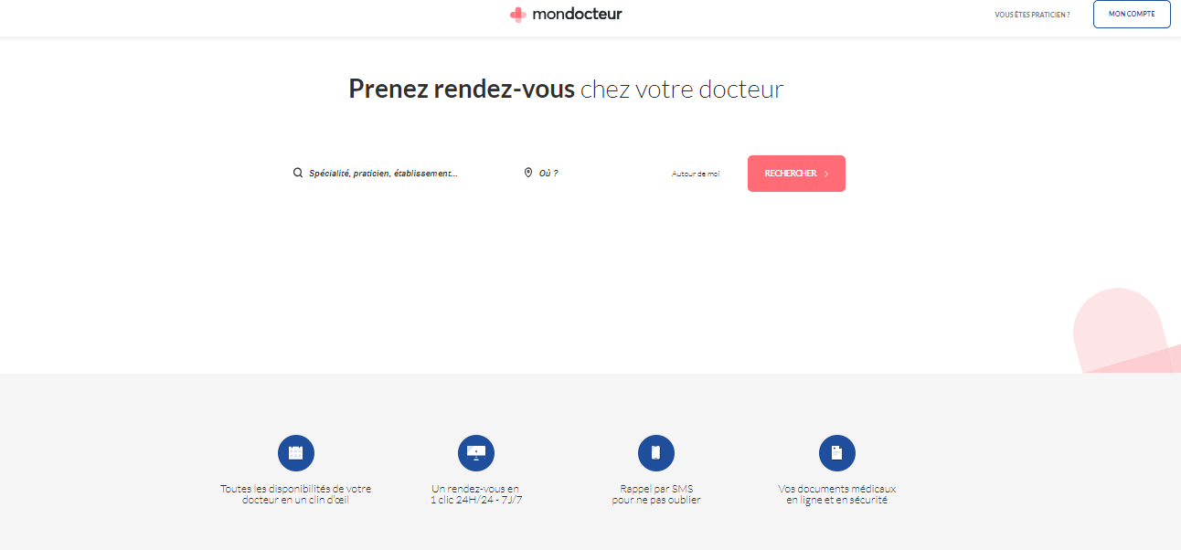
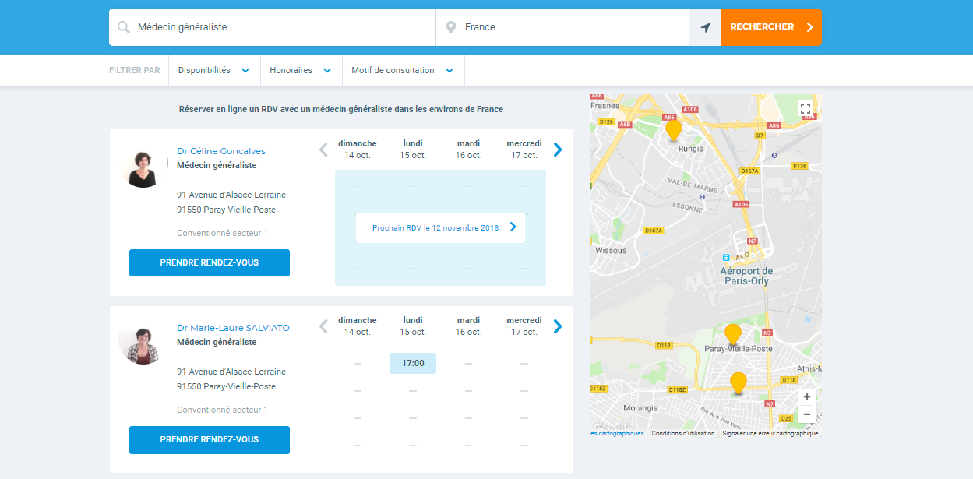
Existing Solutions
Mon Docteur
Doctolib
Notes:
the doctor has no idea about the course of the patient.
The doctor can not recommend to the patient other doctors
the patient has no direct contact with the doctor

Slide 10
Critics
Problem with web site navigation
Too Complicated
No Interaction with user

Slide 11

Solution
Epione
Notes:
Effectivness
Time Consumption
Rich UX/UI
Portability
…

Slide 12
Epione is an intelligent portal for making medical appointments.
The patient chooses his location and the doctor specialty.
The doctor visualizes all his appointments in his space
The application also manages and saves the patient course which helps the doctor to suggest a better treatment for their patients.
the patient is able to ask directly the doctor through the chat option.

Slide 13
Functional Analysis

Slide 14




Actor
Doctor who can create his own account by the administrator confirmation.
Patient the internaut who will register and take appointments.
The simple user Who can only access services that do not require an authentication.
The administrator who manages the other accounts of the system and visualizes the statistics.

Slide 15
Functional requirements
1
Manage patient course .
4
Consult Dashboard
2
Manage appointement
5
Specify availability .
Synchronize program
6
Consult notification .
3

Slide 16
Non Functional Requirements
Efficiency
Flexibility
Performance
Ergonomic
Robustness

Slide 17
Diagrams & Architecture

Slide 18
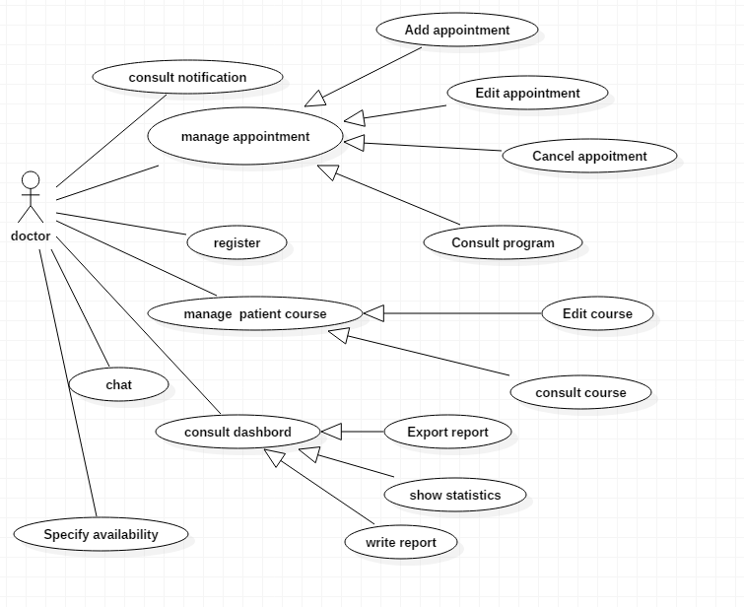
Refined use case diagram
Doctor use case

Slide 19
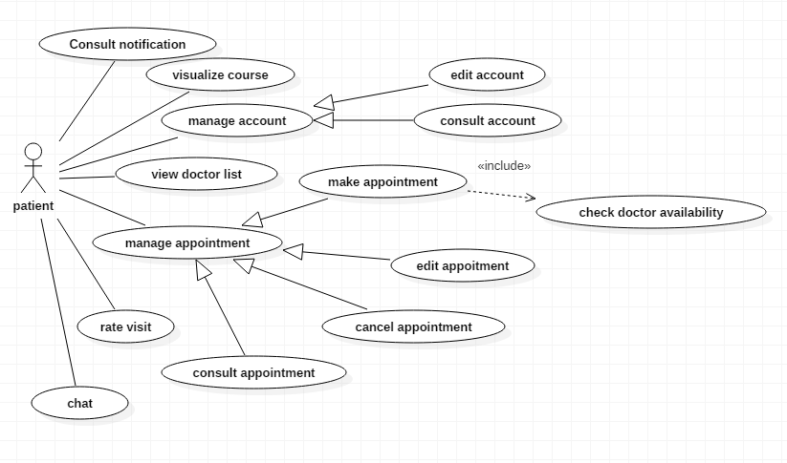
Refined use case diagram
Patient use case

Slide 20
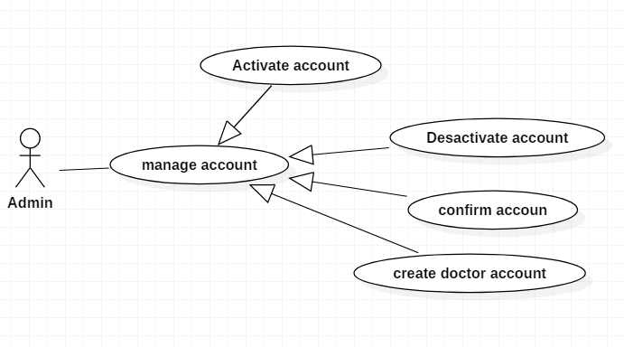
Refined use case diagram
Administrator use case

Slide 21
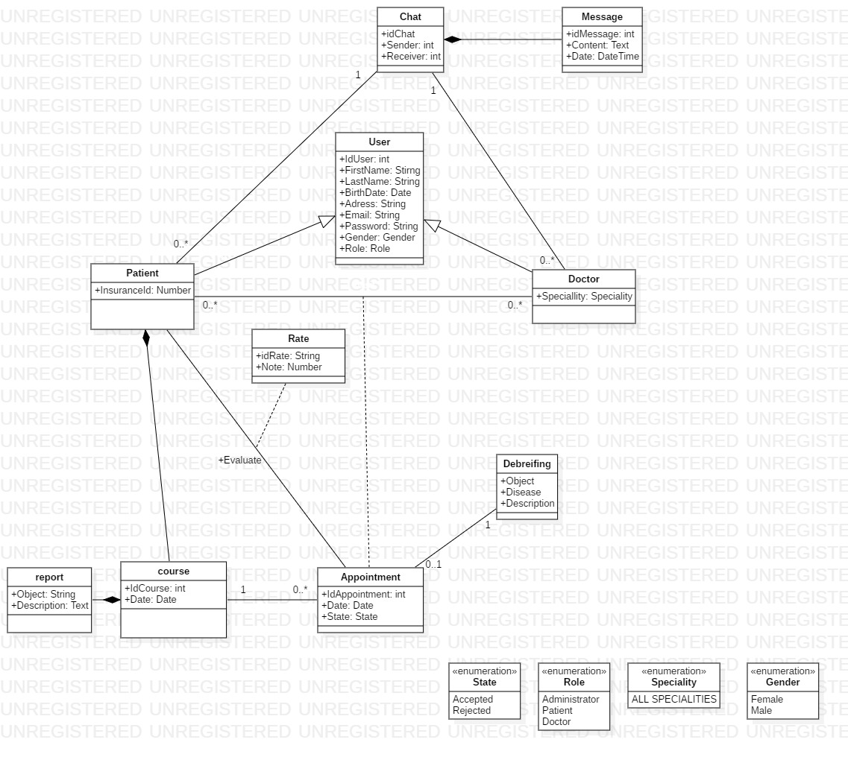
Classes Diagram :

Slide 22
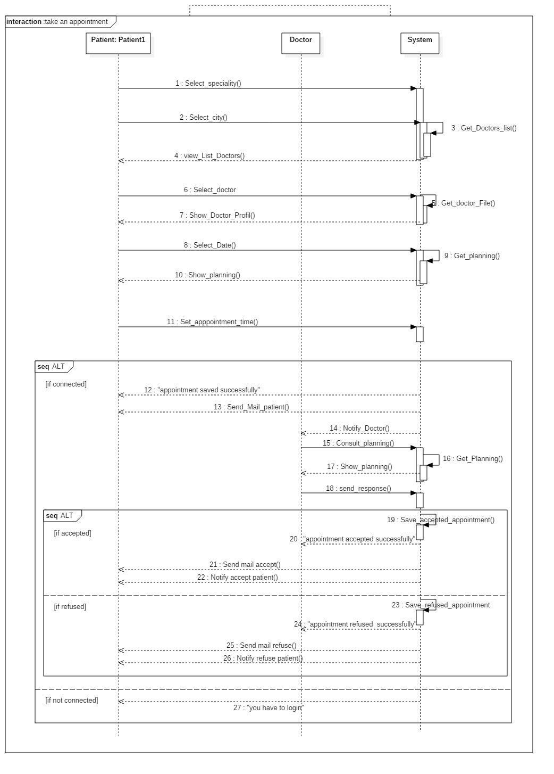
Sequence Diagram
Take an appointment

Slide 23
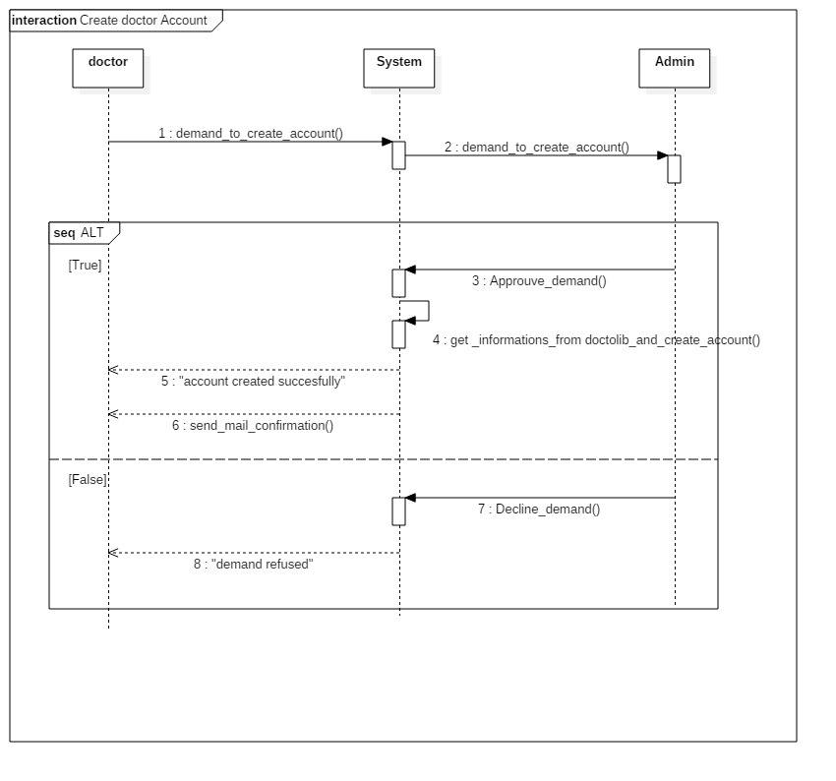
Sequence Diagram
Create doctor account

Slide 24
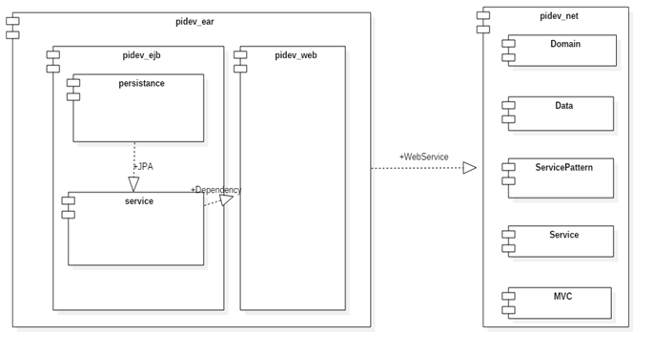
Deployement Diagram

Slide 25
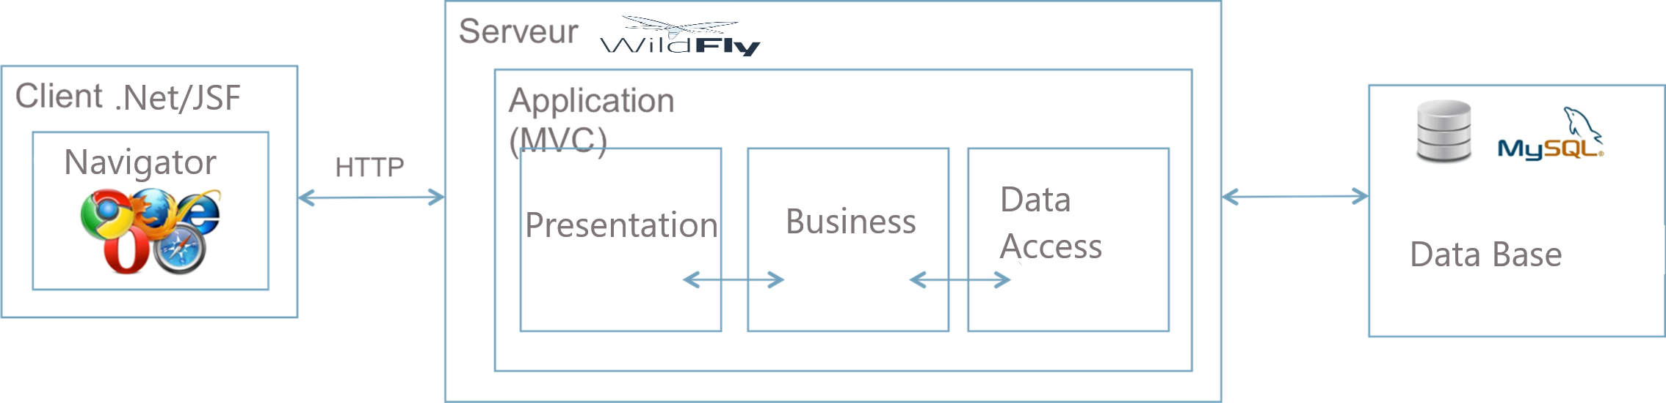
Architecture

Slide 26
scenario
A few User Scenarios..

Slide 27

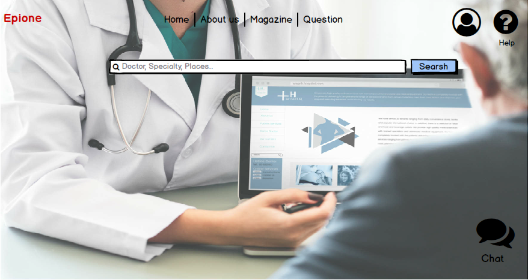
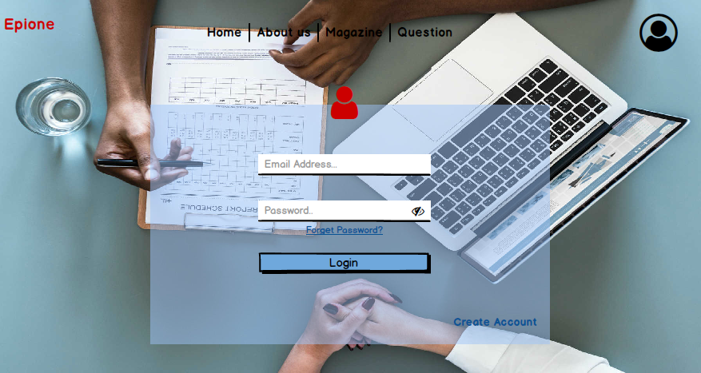

Slide 28
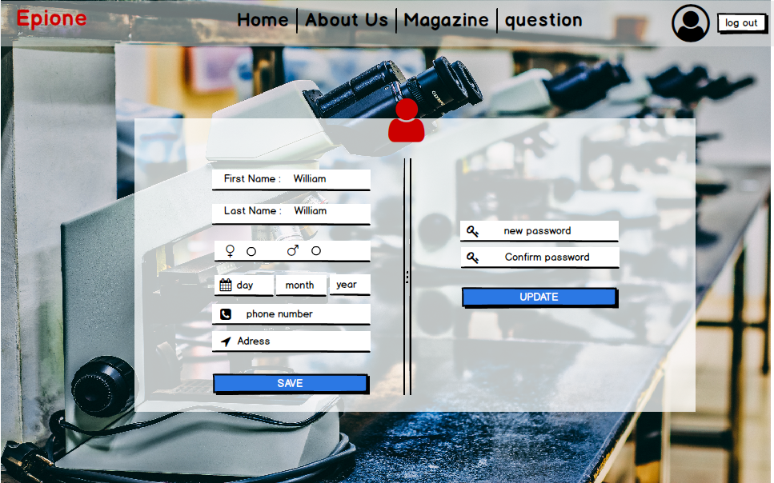

Slide 29
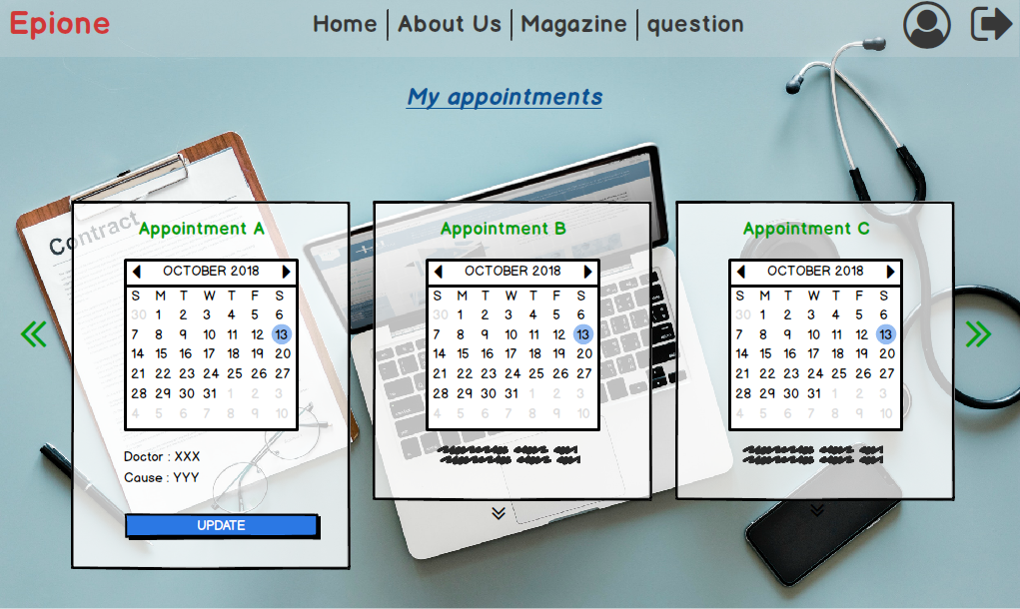
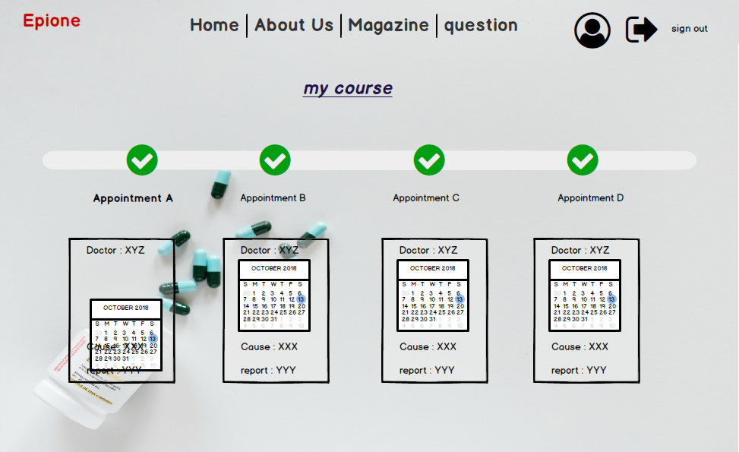

Slide 30
Conclusion & Perspective
As part of our project, we be designing and developing an application that focuses on medical scheduling,
managing and facilitating interaction between doctors and patients.
We are open to make a mobile application that will consume the Same web Services as the other versions,

Slide 31
Thank you for your attention

